Slide 1
AI-based drop-out prediction and counseling system
CSE7302- University Project
Review-1
Batch Number: IST_16
Roll Number | Student Name
Gangula Suresh Reddy | 20221IST0067
Abhinav S | 20221IST0064
Kadavakolla Likhitha | 20221IST0021
Under the Supervision of,
Mr.Jinesh V.N
Assistant Professor
School of Computer Science and Engineering
Presidency University
Name of the Program: Information Science and Technology
Name of the HoD: Dr. Pallavi R
Name of the Program Project Coordinator: Ms. Benitha Christinal J
Name of the School Project Coordinators: Dr. Sampath A K , Dr. Geetha A

Slide 2
Problem Statement Number: SIH25102
Organization: Government of Rajasthan
Category (Hardware / Software / Both) : Software
Problem Description: The project aims to build a system that helps colleges identify students who are at risk of dropping out before it is too late. Currently, attendance, marks, fee status, and subject attempts are stored in different files, making it difficult for teachers to notice patterns of struggle early. As a result, many students disengage and fail without receiving timely support. The proposed solution will bring all student information together in one place, apply simple rules and lightweight machine learning to spot students who show warning signs, and highlight them using easy colour codes. The system will be straightforward to use, require minimal training, and support regular monitoring by mentors and counsellors. By using existing data and avoiding complex tools, the solution will help institutions act early, support vulnerable learners, and reduce dropout rates effectively.

Slide 3
Content
Problem Statement
Objectives
Background and Related work for title Selection
Analysis of Problem Statement
Innovation or Novel Contributions
Git-hub Link
Timeline of the Project
References

Slide 4
Content (continuation)..
Problem Statement: AI-based drop-out prediction and counseling system
Objectives: -
Identify students who are at risk of dropping out early.
Combine attendance, marks, and other records into one system.
Highlight risk levels clearly using colour codes.
Help mentors take timely action and guide struggling students.
Reduce dropout rates using data-driven decisions.

Slide 5
Background
Many students silently fall behind academically long before exam results reveal failure. Declining attendance, repeated subject attempts, and poor internal test scores often go unnoticed because this information is stored separately and reviewed only at the end of the term. As a result, struggling learners disengage from classes and lose confidence without receiving timely support from mentors or counsellors.
Although institutions maintain student data, it is rarely integrated or analysed to identify warning signs early. Faculty rely on manual tracking, which is time-consuming and makes intervention reactive rather than proactive. Public colleges also lack access to costly commercial analytics platforms, leaving them without decision tools used in well-funded institutions. A simple, unified system that brings existing records together and highlights risk can fill this gap, enabling educators to reach out to students before dropout becomes inevitable.

Slide 6
Related Work
Many institutions track attendance, marks, and exam attempts separately, with no combined risk monitoring.
ERP and analytics platforms exist, but they are expensive and difficult for public colleges to deploy and maintain.
Current systems mostly summarise student performance; they do not provide early alerts or personalised intervention support.
Manual tracking approaches depend on faculty time and often detect struggling learners only after failure.
Research on predictive student analytics is growing, but simplified, low-cost tools for widespread academic use are still limited.

Slide 7
Analysis of Problem Statement
Analysis of the Problem:
Student data such as attendance, internal marks, and fee status is scattered across different files and systems.
Warning signs like declining scores and low attendance are noticed late or missed entirely.
Manual tracking by faculty is slow and inconsistent, leading to delayed support.
Colleges lack affordable analytics platforms that combine multiple student performance indicators.
Proposed solutions:
Build a unified dashboard that integrates attendance, assessment scores, and other academic records.
Use simple rules and lightweight machine learning to highlight students at low, medium, and high risk.
Display colour-coded risk alerts to make patterns easy for mentors and faculty to understand
Support timely intervention by counsellors and teachers through regular risk updates and tracking..

Slide 8
Existing Methods and drawbacks
Existing methods
Manual student performance monitoring
Excel-based record keeping
Periodic academic reviews
Traditional email/notice communication
Drawbacks
Time-consuming
No real-time risk prediction
Difficult to handle large data
No automated alerts or follow-up

Slide 9
Proposed Methods & Feasibility Study
Proposed Methods
Web-based dashboard using Streamlit for easy interaction
CSV upload to manage and analyze student data
FastAPI backend to process data and run risk prediction logic
Automated identification of at-risk students
Email alerts sent to mentors and guardians
Centralized data handling for quick decision-making
Feasibility Study
Technical Feasibility: Uses simple, open-source tools (Python, Streamlit, FastAPI)
Economic Feasibility: Low cost; no paid software or licenses required
Operational Feasibility: Easy to use by faculty and admins with minimal training
Time Feasibility: Can be developed and deployed within a short academic timeline

Slide 10
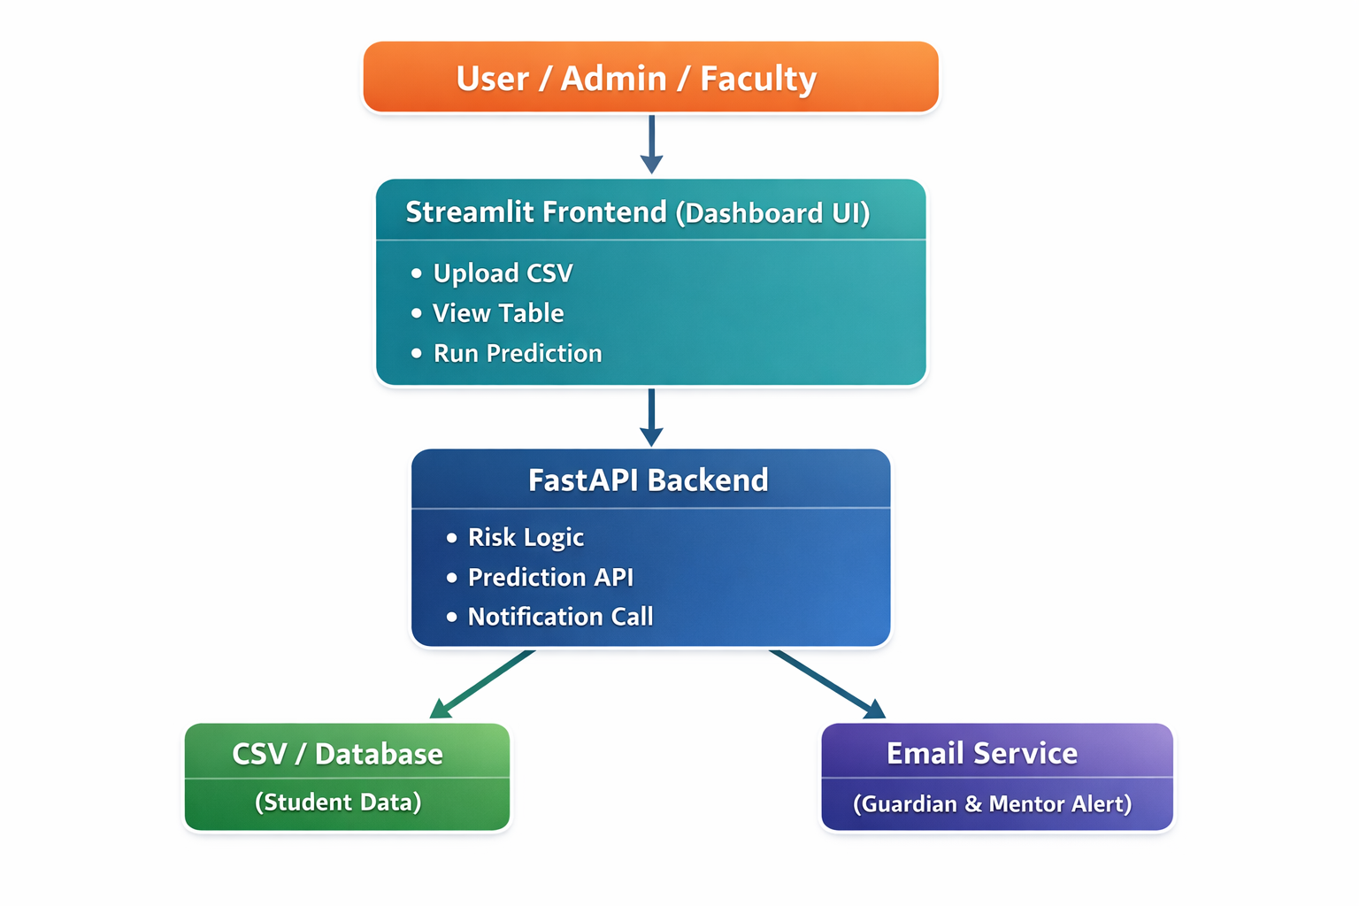
System flow Architechture

Slide 11
Analysis of Problem Statement
Technology Stack Components:
Frontend: Streamlit (Python-based web UI)
Backend: FastAPI (Python), Uvicorn (ASGI Server)
AI/ML (Dropout Risk Prediction & Counselling Logic): Python, Rule-based Machine Learning (Threshold-based classification)
Database: SQLite
Data Handling & Processing: Pandas, CSV / Spreadsheet files
Development Tools: VS Code, Python Virtual Environment (venv), GitHub
Deployment: Localhost, Extendable to Cloud (AWS / Azure / GCP – future scope)
Additional Integrations: Email/SMS notification systems (future scope), CSV/Excel upload modules, Dashboard-based counselling insights

Slide 12
Innovation or Novel Contributions
Unified monitoring system that merges attendance, marks, attempts, and fee data into one platform.
Early-warning alerts that identify struggling students weeks before exams using simple AI-driven insights.
Colour-coded risk levels that make academic challenges easy for non-technical mentors and faculty to understand.
Low-cost, lightweight solution that works with existing spreadsheets and avoids expensive commercial tools.
Empowers educators with timely information instead of replacing human decision-making or judgment.

Slide 13
Github Link
The Github link provided should have public access permission.
Github Link

Slide 14
Analysis of Problem Statement (contd...)
Software and Hardware Requirements:
Software Requirements
OS: Windows / Linux / macOS
Languages: Python
Libraries: Pandas, Requests, Pydantic
Frameworks: Streamlit, FastAPI
Tools: VS Code, DB Browser for SQLite, Web Browser (Chrome/Edge)

Slide 15
Analysis of Problem Statement (contd...)
Software and Hardware Requirements:
Hardware Requirements:
Processor: Intel i5 / AMD equivalent or higher
GPU: Not mandatory (CPU-based processing sufficient)
RAM: 8 GB minimum
Storage: 256 GB
Internet: Stable internet connection (for API calls & development)

Slide 16
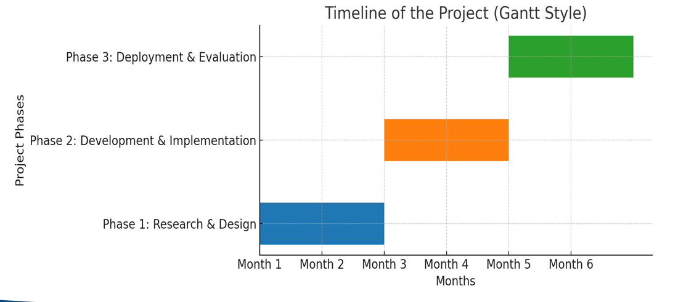
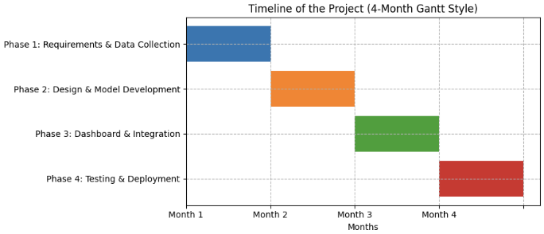
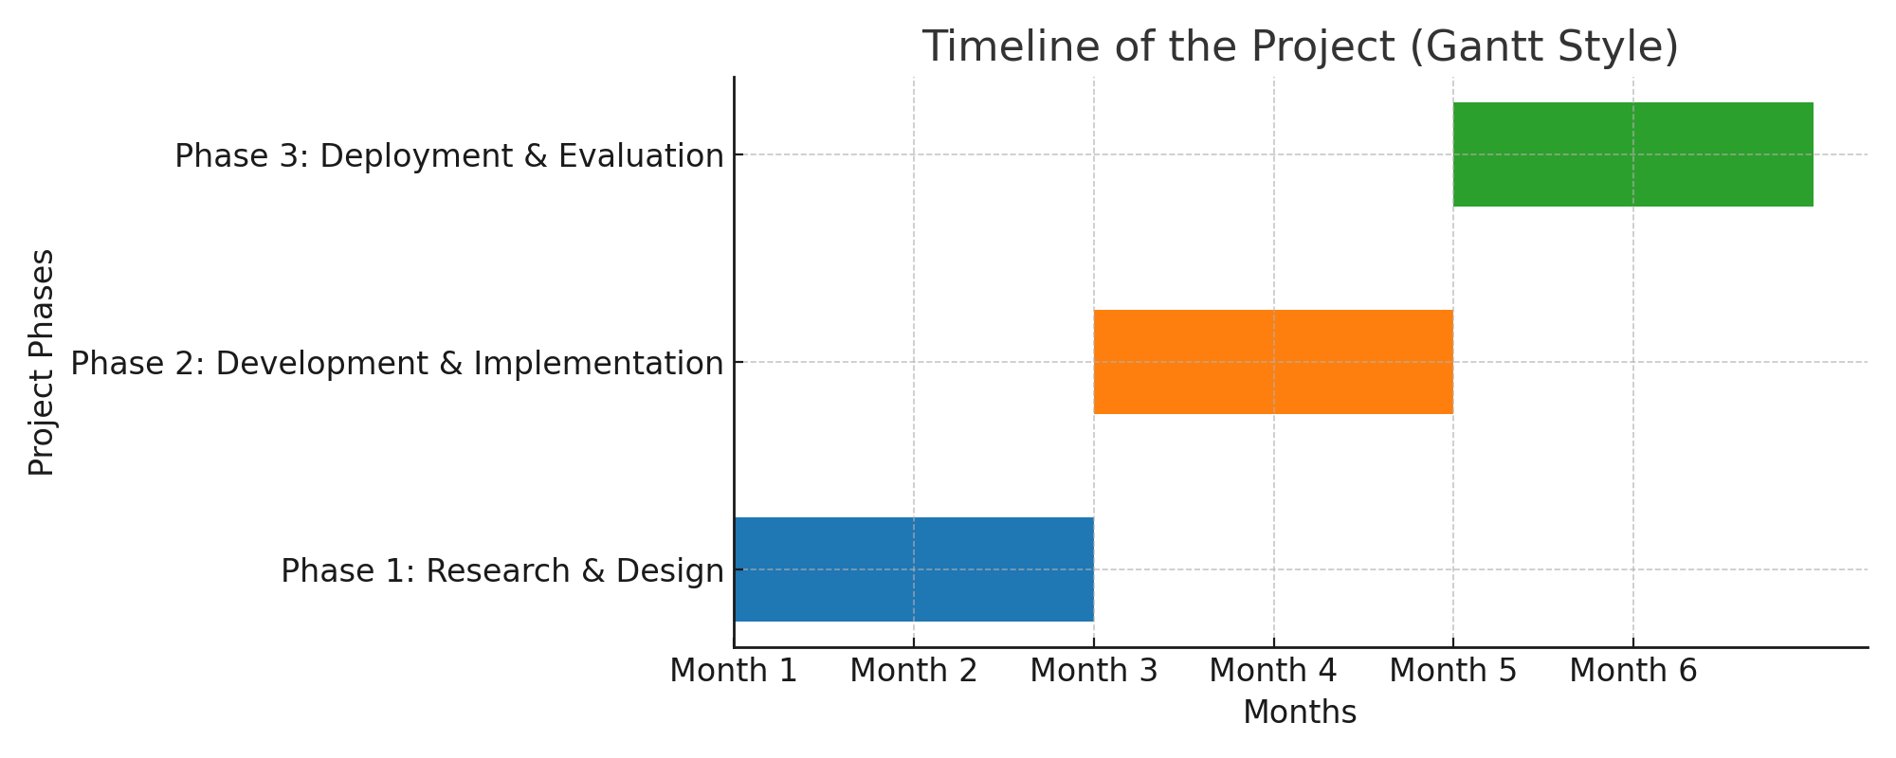
Timeline of the Project (Gantt Chart)

Slide 17
References (IEEE Paper format)
Redefined SDG Mapping:
SDG 4: Quality Education – Ensure inclusive and equitable quality education and promote lifelong learning opportunities for all.
SDG 10: Reduced Inequalities – Provide equal academic support to students from diverse backgrounds by identifying risk early.
Impact:
Helps institutions detect struggling students early and reduce dropout numbers.
Supports mentors and counsellors with timely insights for personalized guidance.
Unifies scattered student records into a single system, simplifying monitoring.
Builds a proactive academic support ecosystem without expensive tools.

Slide 18


